Slide 1

Analysis of Electricity Consumption in Different States using Python
Team Name: S-A-A-B
PG-113 Sumeet Jagtap
PG-067 Anish Krishnan
PG-071 Ayushi Gupta
PG-072 Balkar Singh Manny

Slide 2
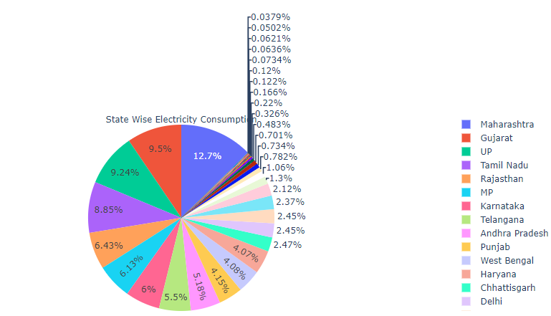
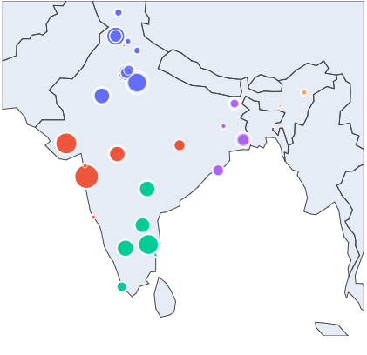
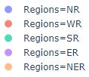
Ranking of States based on electricity consumption for the year 2019-2020
Maharashtra state consumed 12.7% of the total power, which is highest among all the states
Gujarat being second highest with 9.5% consumption
North-Eastern States comprises of less than 1% of the total energy consumed
Sikkim has the lowest consumption rate.
Observations from scatter-geo graph:
Highest Consumption:
Maharashtra in WR
UP in NR
Tamil Nadu in SR
West Bengal in ER
Assam in NER

Slide 3
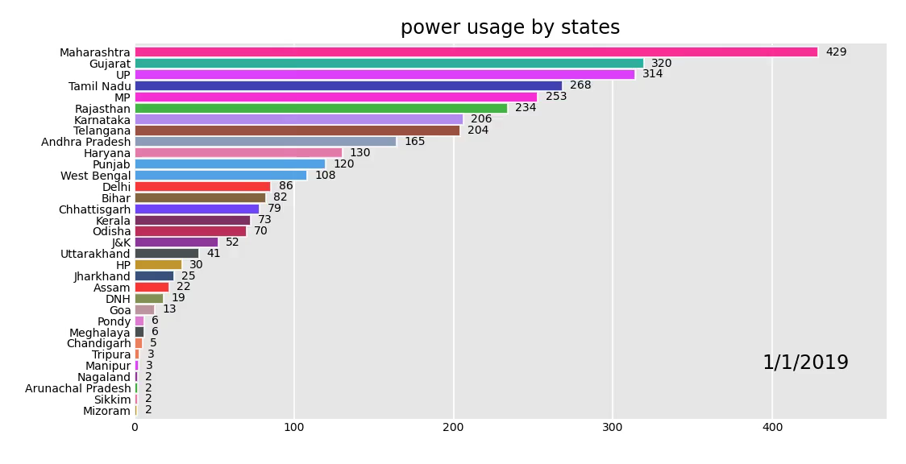
Power Consumption Across the States for the period 2019-2020

Slide 4
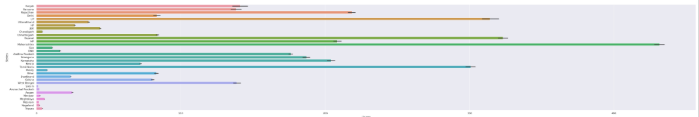
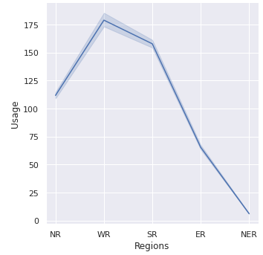
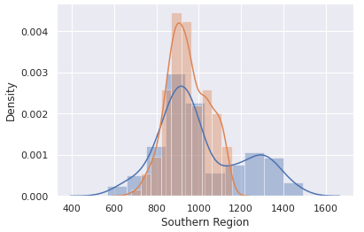
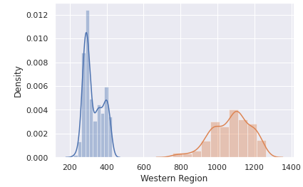
This graph shows the electricity consumption of all the states in a given period, it helps us to compare the consumption in different states and with changing period we can analyze the consumption patters for states, how it changes in different seasons across the year.
Northern Region
Southern Region
Eastern Region
Western Region
Here, we can see that, consumption is more concentrated for northern region than southern region, with mean consumption being slightly higher for northern region.
Mean power consumption is lower for eastern region as compared to western region, while spread is more western region signifying the higher range of consumption in the western region
This graph allows us to compare number of units consumed by each region

Slide 5
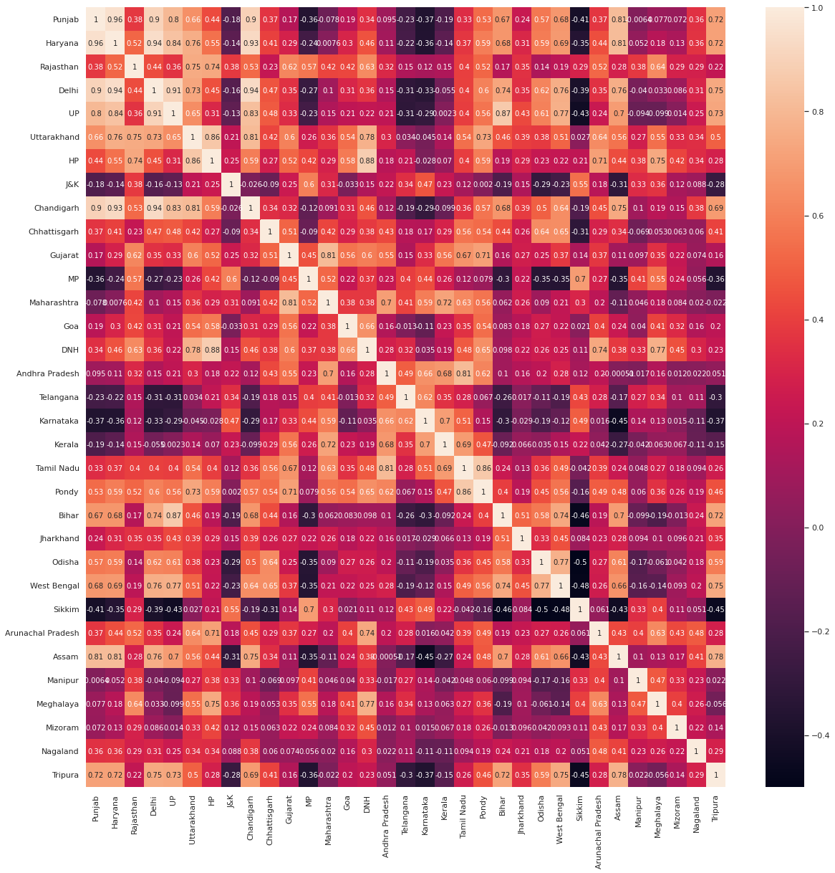
Heat map is graphical representation of data where numbers are expressed as colors
Here we see correlation varying from -1 to +1
+1 being directly correlated and -1 being inversely correlated
The dark and light colors shows the extreme values on the scale, -1 being on darker side while +1 being the lightest color on the map
Darker color shows that the two data points on the map are from the opposite ends of the spectrum

Slide 6
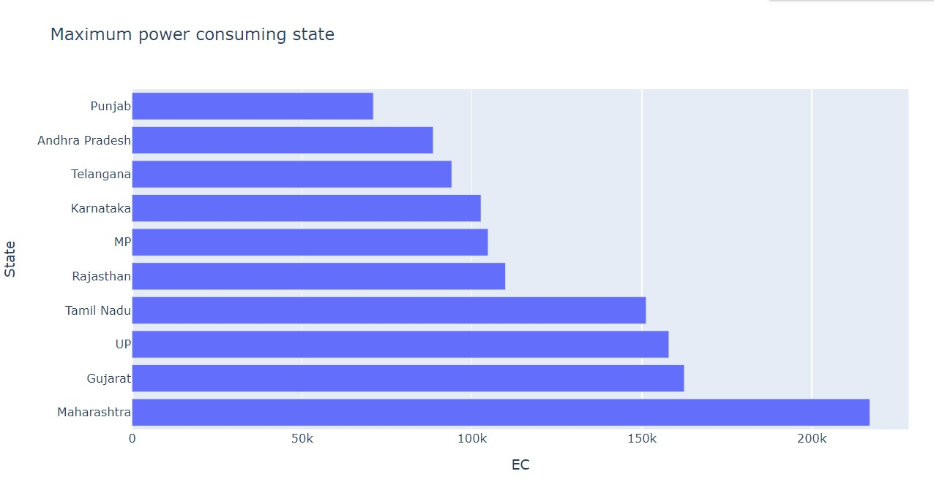
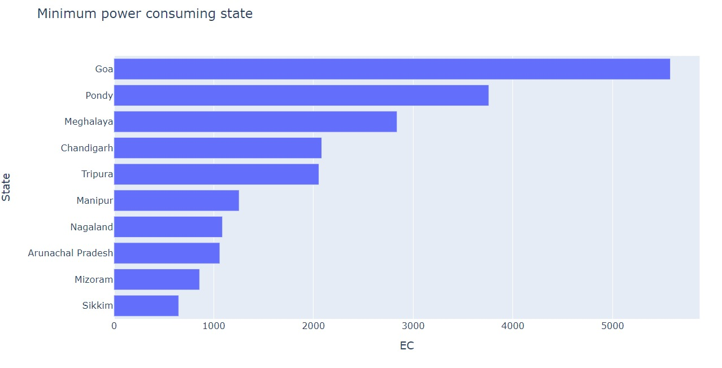
The graph displays top 10 maximum power consuming states in the period 2019-2020
Maharashtra being at top with highest power consumption, followed by Gujarat and UP
The graph displays bottom 10 minimum power consuming states in the period 2019-2020
Sikkim being the lowest power consuming state followed by Mizoram and Arunachala Pradesh

Slide 7
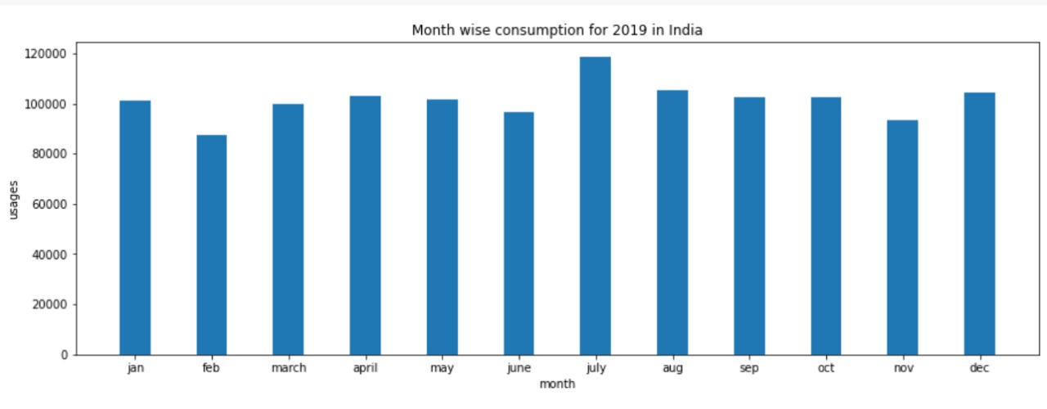
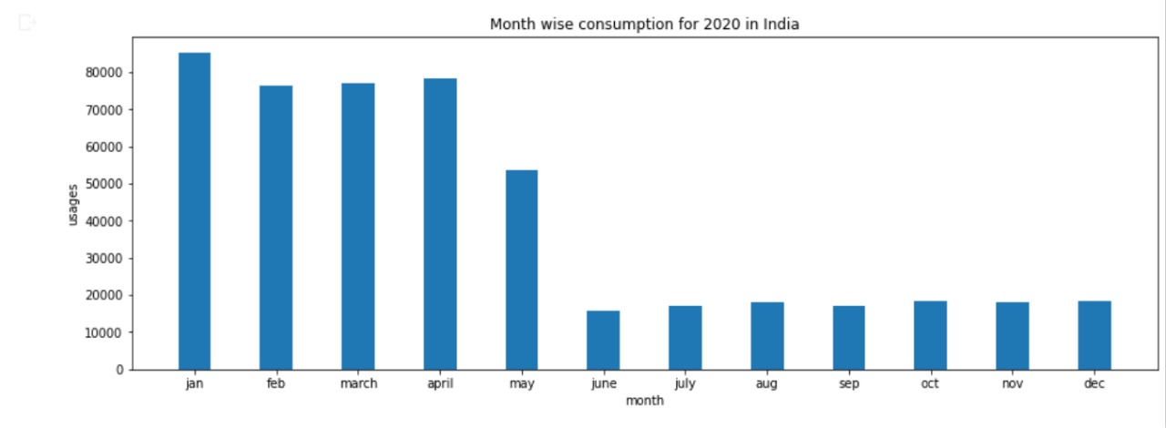
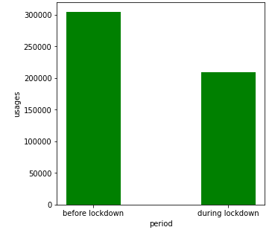
The overall electricity consumption in the country decreased during the initial period of lockdown with dramatic reductions in consumption of services and industry only partially offset by higher residential use.
 | 2019 | 2020
Max Consumption | July | Jan
Min Consumption | Feb | June
Change in Power Consumption Before & After lockdown

